Slide 1
Notes:
Not every motive behind the Reformation was from pure and noble intentions. While men like Luther, Zwingli, and Calvin were righteously indignant by the immorality and unbiblical nature of the Roman Catholic church, other men were motived to reform merely for social and political reasons. In this lesson, we’ll look at one such individual whose motive for separating from the Roman Catholic church was self-serving – Henry VIII. Henry VIII was king of England and would spear-head the English Reformation movement, a movement which would have far reaching consequences throughout history.

Slide 2
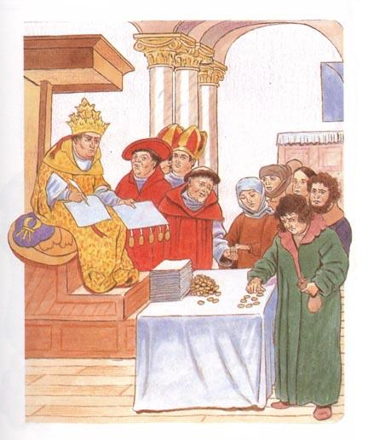
Reformation in England
England Was Ripe
John Wycliffe’s teaching
Catholic corruption
English loved their freedom
Financial Corruption
Notes:
For many decades prior to Henry VIII, England was ripe for reformation. John Wycliffe, who was English himself, had already done extensive work in that area in both preaching and in translating the bible into the English language. He spent several years planting seeds in the minds of the English regarding the corruption of the Catholic church. Other lesser known men followed in his stead and kept the ideas alive in the minds of the English.
Much of England were not blind to the corruption of the Catholic church regardless of reformist teaching – they were ready for change.
England grew tired of the Pope’s controlling nature and wanted their freedom. They just needed the right man in the right position to take the next step. They would find this in King Henry VIII, even if it was for selfish reasons.
Also, the vast bulk of the population were very angry at the way the Roman Catholic Church had used them as a source of money. To get married you had to pay; to get a child baptized (which you needed to be if you were to go to Heaven as far as the Catholic Church preached) you had to pay; you even had to pay the Church to bury someone on their land (which you had to do as your soul could only go to Heaven if you were buried on Holy Ground). Therefore, the Catholic Church was very wealthy while many poor remained just that….poor. Their money was going to the Catholic Church.

Slide 3
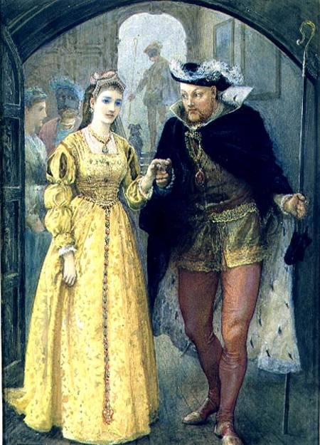
Reformation in England
Henry VIII’s Marriage
Henry was married to Catherine of Aragon, daughter of Ferdinand & Isabella of Spain
Henry never loved her (widow of his brother)
She bore him 6 children, but only one daughter survived (Mary); he argued that he ought to have a son to succeed him
He happened to be in love with Anne Boleyn, an attendant in the queen’s court
Henry asked the Pope for permission to divorce Catherine and marry Anne
The Pope refused the request
Henry divorced Catherine anyway and married Anne in 1533
The Pope excommunicated Henry in 1534
Notes:
Henry VIII decided to rid himself of his first wife, Catherine of Aragon, after she had failed to produce a male heir to the throne. He had already decided who his next wife would be - Anne Boleyn. By 1527, Catherine was considered too old to have anymore children. However, a divorce was not a simple issue. In fact, it was a very complicated one. Henry VIII was a Roman Catholic and the head of this church was the pope based in Rome.
The Roman Catholic faith, despite all of its many problems, believed in marriage for life. It did not recognize, let alone support, divorce. Those who were widowed were free to re-marry; this was an entirely different issue. But husbands could not simply decide that their marriage was not working, divorce their wife and re-marry. The Roman Catholic Church simply did not allow it.
This put Henry VIII in a difficult position. If he went ahead and announced that as king of England he was allowing himself a divorce, the pope could excommunicate him. This meant that under Catholic Church law, your soul could never get to Heaven. To someone living at the time of Henry, this was a very real fear and a threat which the Catholic Church used to keep people under its control. Another approach Henry used was to make a special appeal to the pope so that he might get a special "Papal Dispensation". This meant that the pope would agree to Henry’s request for a divorce purely because Henry was king of England but that it would not affect the way the Catholic Church banned divorce for others. The pope refused to grant Henry this and by 1533 his anger was such that he ordered the Archbishop of Canterbury to grant him a divorce so that he could marry Anne Boleyn.
The Archbishop granted Henry his divorce against the wishes of the pope. But what else could the archbishop do if he wanted to remain on good terms with Henry? This event effectively led to England breaking away from the Roman Catholic Church based in Rome. Henry placed himself as head of the church and in that sense, in his eyes, his divorce was perfectly legal. In 1533, few were brave enough to tell him otherwise!
How did the people of England react to this? There were no great protests throughout the land as many felt that Henry would ease up on taking money from them. Henry knew of the Catholic Church’s unpopularity and, therefore, used this to his advantage.

Slide 4
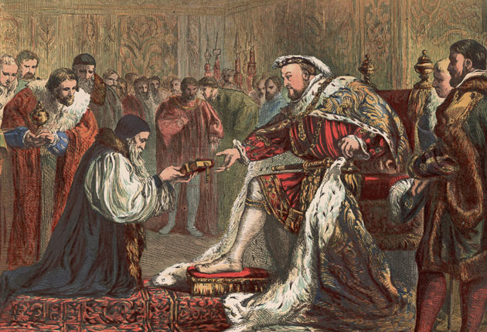
The Church of England
Henry proclaims himself head of the Catholic Church in England
Was able to get Parliament to make the act official by cutting off the English Church from Rome and declaring the King head of the church (Act of Supremacy)
The Catholic church in England changed its name to the “Anglican Church” or “Church of England”
Held to protestant doctrine under catholic organization
Notes:
Henry was made Supreme Head of the Church by an Act of Parliament in 1534. The country was still Catholic but the pope’s power there had now ended. The most wealthy Catholics in England were the monasteries where monks lived. They were also the most loyal supporters of the pope. This made them a threat to Henry. By the time of Henry, many monks had grown fat and were lazy. They did not help the community as they were meant to do. All they seemed to do was take money from the poor. Also some monasteries were huge and owned vast areas of land. So here were monks not loyal to Henry who were also very wealthy. Henry decided to shut down the monasteries of England. The monasteries were to disappear like sugar dissolves in hot liquid. This is why Henry’s attack on the monasteries is called the 'Dissolution' - they were to be dissolved!
Henry wanted a complete separation from the Catholic church and so he renamed his body the Church of England. Though the organization remained similar to Catholicism, the doctrines that the church upheld were mostly of protestant origin of which we will look at in detail later.

Slide 5
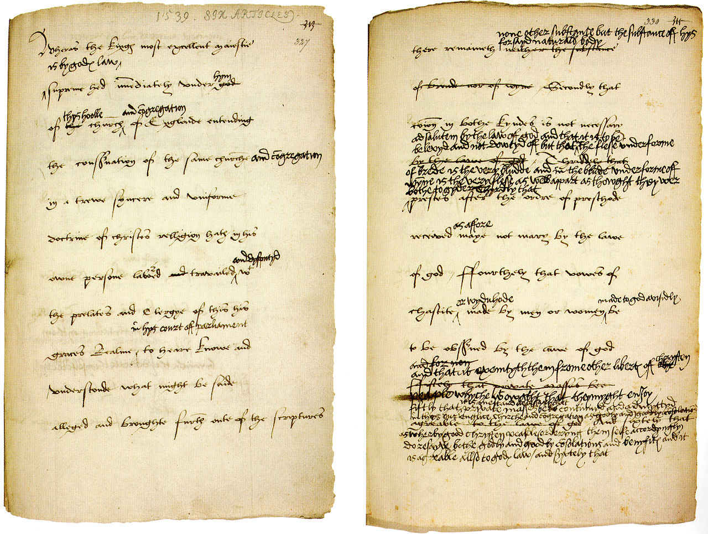
The Church of England
Henry drafted 10 Articles in 1536, summarized as follows:
“The authoritative standards of faith are the Bible, the Apostles’, Nicene, and Athanasian creeds, and the ‘four first councils.’ Only three sacraments are defined: baptism, penance, and the Lord’s Supper; the others are not mentioned in approval or denial. Justification implies faith in Christ alone, but confession and absolution and works of charity are also necessary. Christ is physically present in the supper. Images are to be honored but with moderation. The saints are to be invoked, but not because they ‘will hear us sooner than Christ.’ Masses for the dead are desirable, but the idea that the ‘bishop of Rome’ can deliver out of purgatory is to be rejected.”
Later enlarged to 42 Articles, then in 1563 into 39 Articles – the formal statement of faith for the Church of England
Notes:
In 1536, Henry drafted 10 articles to be used as the creed of the Church of England. It was later enlarged to 42 articles and then in 1563 it settled on 39 articles and that is now considered the formal statement of faith for the Church of England. As with other reformation movements, the Church of England looks to standards outside of the bible by its adhering to and constructing of creeds. If a creed says more than the bible, it says too much. If it says less than the bible, it says too little. If it says the same as the bible, we should only need to put our faith in the bible.

Slide 6
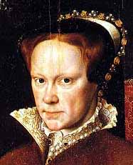
The Church of England
Being born of social & political expediencies, trouble lay ahead
When Henry died in 1547, his son Edward, who had a Protestant mother, came to the throne and continued his Father’s work
At Edward’s death, “Bloody Mary”, daughter of Henry and Catherine, ascended the throne
England experienced a “Catholic Reaction”. Mary had up to 400 people put to death who opposed Catholicism
When Mary died, Elizabeth, daughter of Henry and Anne Boleyn, began to rule and she re-directed England back toward Protestantism
Notes:
When Henry died in 1547, religious problems continued in England. Henry’s 9-year old son Edward VI became king though Edward Seymour was made Lord Protector until such a time that Edward was old enough to rule. Edward was raised by his protestant mother and so he continued the reforms began by Henry by dismantling all images from church buildings, prohibiting vestments, and lifting the requirement for the clergy to be celibate. Catholic doctrines were adapted to take on a more protestant appeal.
However, when Edward died, Mary ascended to the throne in 1553. Mary was raised Roman Catholic and therefore repealed the Reformation legislation of her father and worked to reunite the Church of England with Rome. Though this proved difficult for a variety of reasons, the medieval heresy laws were again enforced and many protestants in England were tortured and brutally executed giving her the nickname “Bloody Mary”. Her premature death in 1558 left her without an heir to the throne and ended her attempt to convert the church back to Rome.
When Mary died, her half-sister Elizabeth took the throne and she redirected England back towards Protestantism. Puritanism arose during her reign in that some wanted a more radical reform of the church than that which had become the church of England.

Slide 7
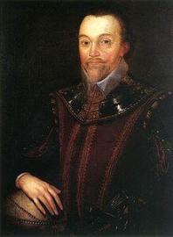
The Church of England
History in America
Planted in California by Sir Francis Drake in 1578
Grew fast in the South and West but made little headway in the East for many years
American Revolution almost destroyed the Church of England in America
Most clergy were loyal to the King of England
They fled back to England during the latter part of the war
In 1783, reorganization came and the name “Protestant Episcopal Church” was adopted
Notes:
In 1578, Sir Francis Drake landed his ship in Northern California and conducted the first Anglican church service. A number of Indians gathered to watch the men perform their worship service. From this time, the Anglican church made headway in the west and then in the south but made very little headway in the East. When the Revolutionary War was over, most clergy were to loyal to the King of England and so they fled back to England which almost destroyed the Church of England in America. However, it slowly grew again and in 1783 it reorganized and renamed itself in America to the Protestant Episcopal Church once it lost its connection to England.

Slide 8
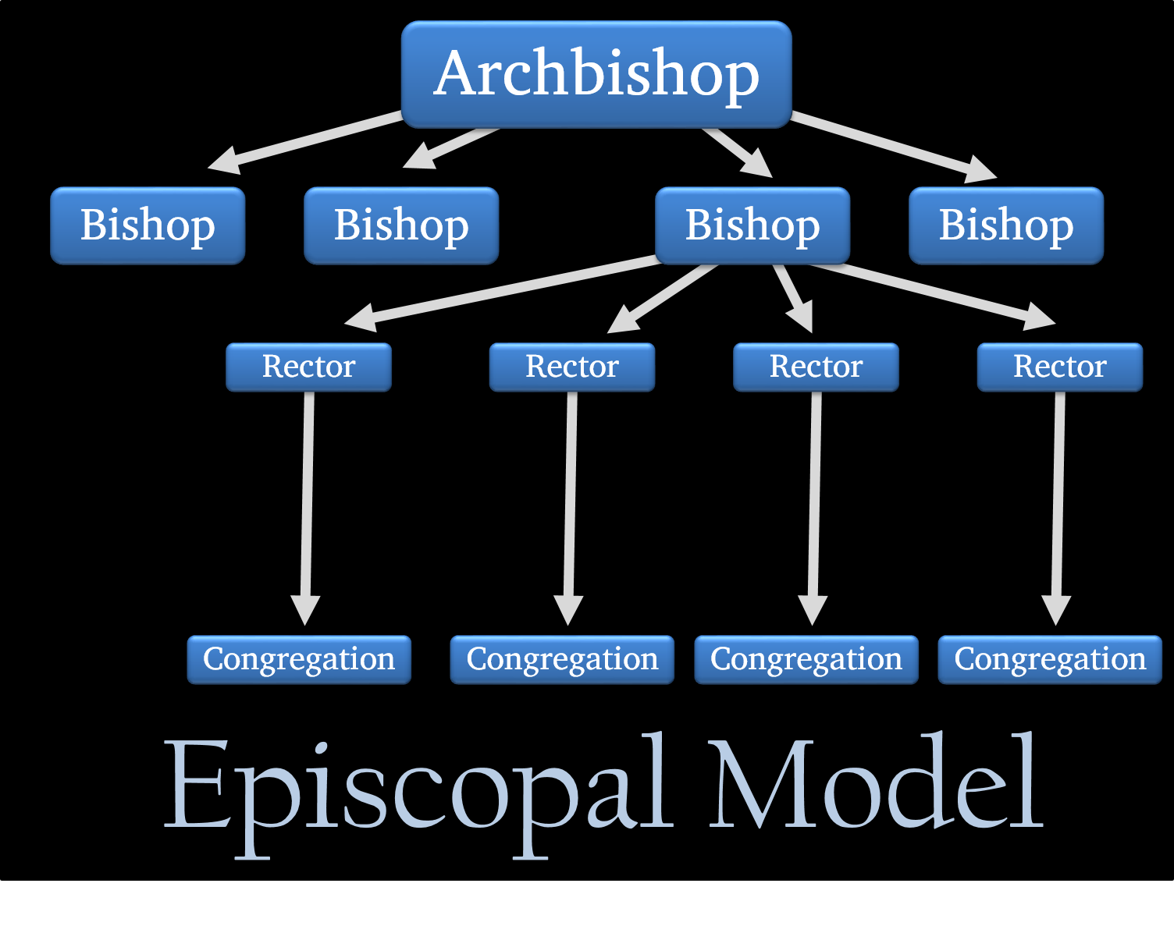
Episcopal Church
Government
Ecclesiastical head of the Church is the Archbishop elected by the general convention. He serves to the age of 72
Every 3 years, there is a general convention composed of two houses – Bishops and deputies. Laws passed here must be submitted to the dioceses for ratification before becoming law
Government in the diocese is vested in the Bishop and the diocesan convention, composed of clerical and lay members, which meets annually
Basic unit is the parish, overseen by the Rector (Priest)
Parishes are grouped geographically into 74 dioceses. The dioceses elect the bishops
Wardens have charge of the church records and collection of alms
Vestrymen in charge of all church property
Notes:
It is called the “Episcopal” Church because it is governed by bishops with one elected archbishop overseeing them. Beneath each bishop are rectors (priests) who preside over each parish. Also within the parish are wardens who are in charge of church records and alms and then vestrymen who are in charge of church property. Each parish is grouped geographically into 74 dioceses.

Slide 9
Episcopal Church
Doctrines
Children are born in sin; must be regenerated in baptism (Book of Common Prayer, pp. 273, 274)
“Baptism” can be performed either by pouring or immersion (Ibid., p. 279)
“That we are justified by faith only is a most wholesome doctrine and very full of comfort” (Ibid., p. 605;)
Jesus “died to reconcile His Father to us” (Ibid., 9. 603)
Special days are observed (Ibid., pp. 50, 51)
Believe Ten Commandments still binding Ibid., p. 68)
Notes:
Episcopal doctrine contains elements of both Catholicism and Protestantism. They have formed a pyramid organizational structure similar to that of the Catholic church, but maintain core doctrine influenced by Protestantism.
They’re belief in original sin means they baptize infants, believing it can be done by either pouring or immersion contrary to Rom 6:3-4.
They believe in justification by faith only contrary to Jas 2:24.
Interestingly, they believe that Jesus died to reconcile the Father to us rather that the opposite that is taught in 2 Cor 5:19-21.
They also believe in the observance of special days contrary to the teaching of Gal 4:10-11. Finally, they believe that the ten commandments today are still binding, contrary to the teaching of Col 2:14, Heb 8:7-8, 10:9-10.
Like most protestant denominations, the Episcopal church did not follow its reformation through to the end and stopped short of the church we find in the writings of the New Testament.

Slide 10
Notes:
As we study church history, we want to be careful to make sure we learn the practical applications to help us in our walk with God today. History contains more than just stories, but also action/reactions that are similar to the issues we encounter in the 21st century. Learning where early Christians succeeded and failed will help us solidify our faith.

Slide 11
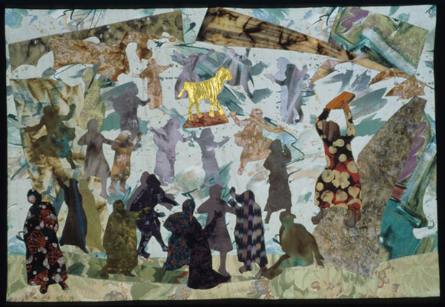
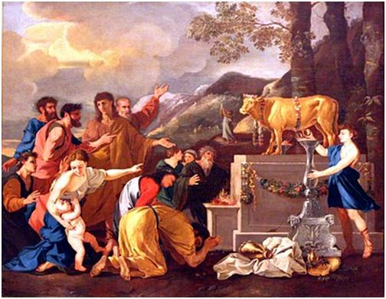
Practical Applications
Churches that start by selfish means never prosper
Micah’s idols – Judg 17-18
The Sin of Jeroboam – 1 Kings 12:25-33

